Slide 1

Rockbuster Stealth LLC
Business Analysis
Stephanie Monson
May 2022

Slide 2
Project Overview
Entity: Rockbuster Stealth LLC is a movie rental company with retail stores around the world.
Environment: Facing stiff competition from streaming services such as Netflix, Amazon Prime and Hulu.
Endeavor: Rockbuster Stealth management team is planning to use its existing movie licenses to launch an online video rental service in order to stay competitive.

Slide 3
Project Objectives
Which movies contributed the most/least to revenue gain?
What was the average rental duration for all videos?
Which countries are Rockbuster customers based in?
Where are customers with a high lifetime value based?
Do sales figures vary between geographic regions?

Slide 4
Current Film Rental Detail
 | Minimum | Maximum | Average
Rental Rate | .99 | 4.99 | 2.98
Rental Duration (days) | 3 | 7 | 5
Film Length (minutes) | 46 | 185 | 115
Replacement Cost | 9.99 | 29.99 | 1999

Slide 5
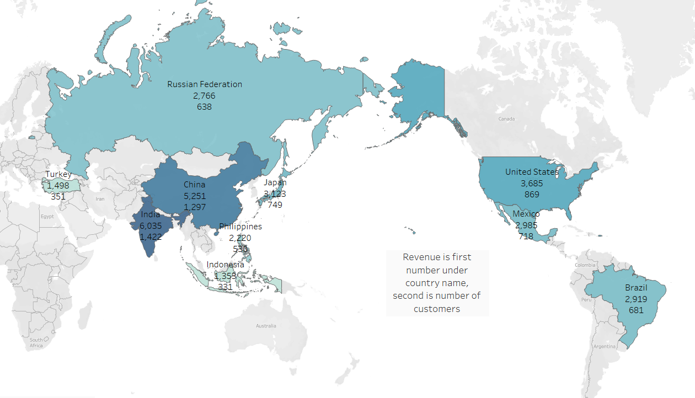
Top 10 Countries by Revenue and Customer Count -Asia is largest area by both revenue and customers -North America is second largest area by revenue and customers

Slide 6
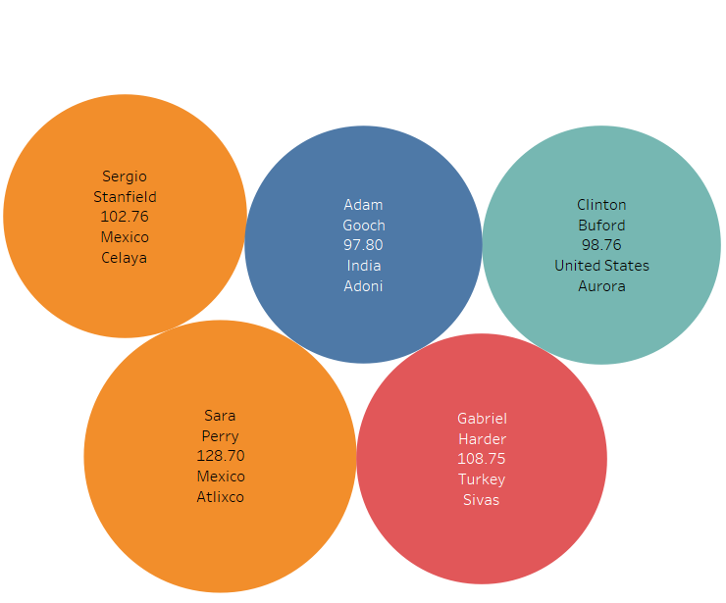
Top 5 Customers by Amount Paid with Country and City 2 of the highest paying customers are located in Mexico Rockbuster may look to providing current customers with a survey. Possible areas of inquiry: favorite types of movies, streaming preferences (day of week, duration, desire for streaming options).

Slide 7
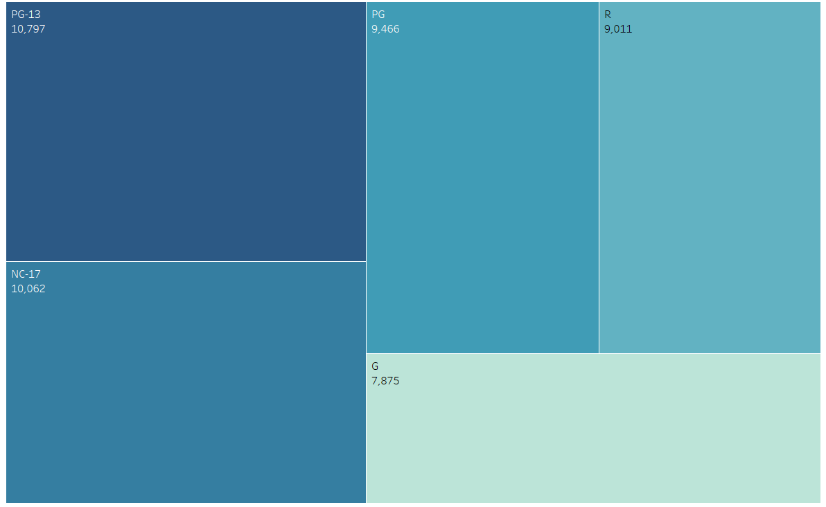
Film Revenue by Rating Top 2 ratings are PG-13 NC-17

Slide 8
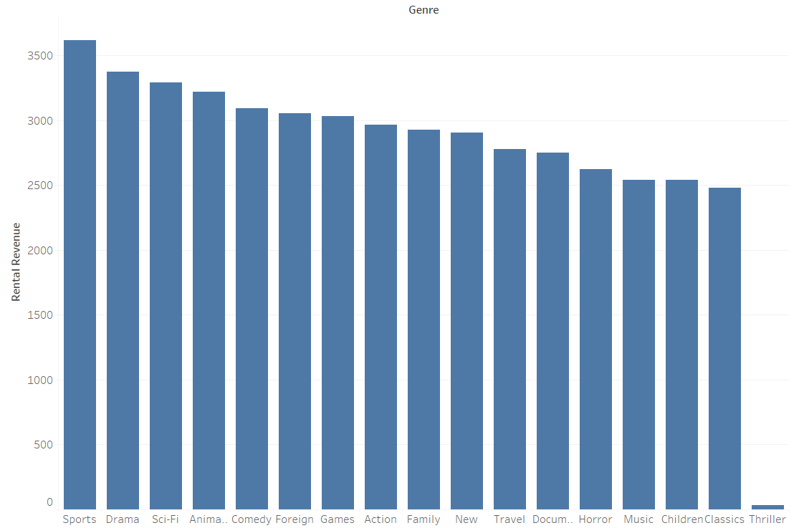
Top 5 Film Revenue by Genre: Sports Drama Sci-Fi Animation Comedy

Slide 9
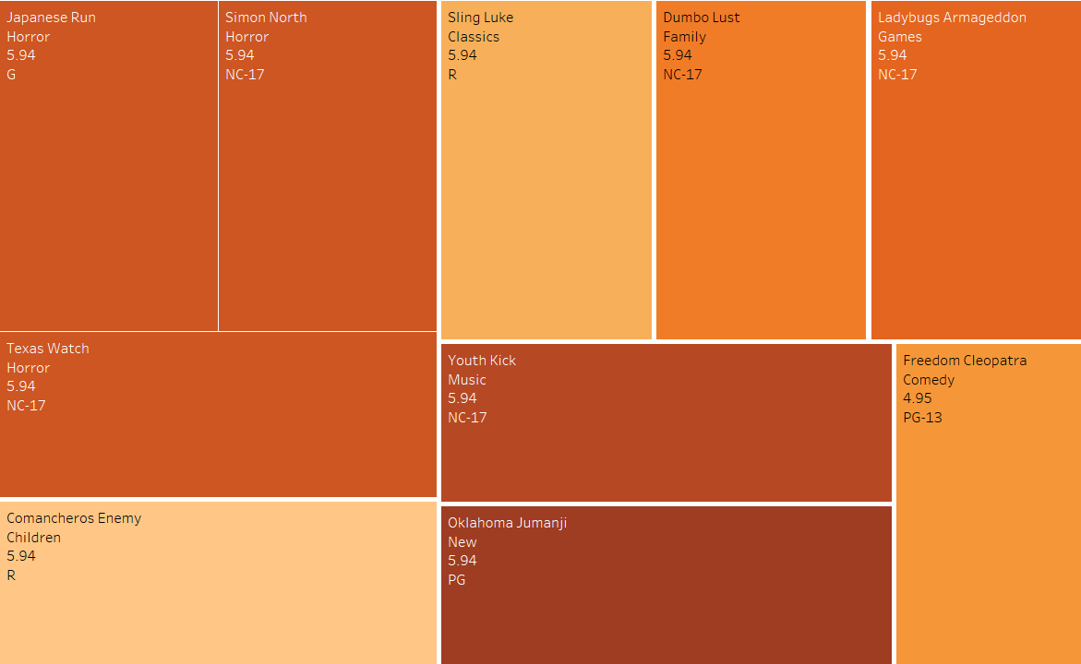
10 Lowest Revenue Titles with Genre and Rating

Slide 10
Insights and Recommendations
Remove lowest revenue films from inventory.
Refresh inventory with new movies from highest revenue genres.
Institute a customer loyalty reward program, for example-current customers may get reduced streaming rates for a specified period and/or customers accrue points through rentals redeemable for future rentals.
Concentrate marketing efforts in highest revenue countries to include information on customer loyalty/reward program and incentives for new customers.

Slide 11
Questions? stephmtwo@gmail.com
Tableau Link:
https://public.tableau.com/app/profile/stephanie.monson/viz/RockbusterStealLLCAnalysis/Story1?publish=yes

